Slide 1

Elwood Community School Corporation
2026 Fall Property Tax Analysis
February 19, 2026

Slide 2
Assumptions & Methodology
Overview of SEA-1 Changes
Homestead Deductions
Increased from 37% of assessed value in 2025, phased in over time, to 67% of assessed value for taxes due in 2031. Standard deduction is phased out by 2031.
2% Cap Tax Class Deductions
New deduction for non-homestead residential (2% circuit breaker class such as apartments, long-term care facilities and agriculture), phasing in each year to 33% by 2031
Homestead Residential Credit
New credit for homestead residential properties equal to the lesser of 10% of the taxpayer liability or $300. To be applied after Constitutional circuit breaker caps.
De Minimis Business Personal Property Exemption
Exemption threshold for de minimis business personal property (purchase price $2M or less) increases from $80K in 2025 to $2M for 2027.
Business Personal Property 30% Floor
With certain exceptions, new business personal property purchases are exempted from the 30% floor and therefore will continue to depreciate below 30% of cost.
Farmland Assessed Value
New methodology for agriculture base rate beginning in 2026 including the capitalization rate changed from 8% to 9% for January 1, 2025 and January 1, 2026.
Elimination of Deductions
Most non-local property tax deductions are eliminated for taxes payable in 2026 such as solar energy, wind, geothermal, etc. Other historic deductions such as over-65, blind/disabled were converted to credits.

Slide 3
Tax Base Profile

Slide 4
Tax District Composition
Tax Districts
Homestead Parcel Count by Assessed Value
Pay 2025
 |  | 2026 |  |  | 2025 |  |  | 2026
District | District Name | Certified Net AV | Percent of Tax Base |  | Parcel Count | Parcels at CB Cap |  | Median Homestead GAV
48010 | Duck Crek Twp - Elwood Sch | $19,974,590 | 4.8% |  | 143 | 96 |  | $193,700
48011 | Elwood City - Duck Creek Twp | $4,943,490 | 1.2% |  | 72 | 64 |  | $232,500
48026 | Pipe Cr.Twp. Elwood Sch. | $53,893,790 | 12.9% |  | 1,241 | 613 |  | $126,100
48027 | Elwood City Pipe Cr.Twp. | $339,354,865 | 81.2% |  | 6,726 | 5,653 |  | $78,550
Total |  | $418,166,735 | 100.0% |  | 8,182 | 6,426 |  | $84,100
8,182
Total Parcels
Parcels at Cap by Property Cap
Pay 2025
79%
Parcels at the Circuit Breaker Cap
$84,100
Total Median Homestead Assessed Value

Slide 5
Tax Base Composition
Gross Assessed Value
Pay 2026
Net Assessed Value
Pay 2026
Net Assessed Value without TIF Increment
Pay 2026
Total GAV: $669.7M
Total NAV: $415.8M
Total NAV w/o TIF: $338.7M

Slide 6
Assessed Value Outlook

Slide 7
Gross Assessed Value Outlook
Gross Assessed Value
Pay 2026
GAV Change by Property Class
Pay 2025 to Pay 2026
Gross Assessed Value is the “market value” or value-in-use of the property.
The value as of January 1, 2025 is used as the assessed value for taxes payable in 2026.
For Pay 2026, DLGF updated the cost tables which has the potential to affect apartments, commercial, and industrial sectors.

Slide 8
Gross Assessed Value Outlook
Madison County Single Residential Sale Price
January 2015 to July 2025, Dollars in Thousands
 | Average Price | Pct Change
2021 | $156K
2022 | $172K | 10.1%
2023 | $192K | 11.5%
2024 | $192K | 0.0%
2025 | $194K | 1.2%
 | Annual Avg Change | Annual Pct Change
2015-2019 | $10K | 10.4%
2019-2022 | $18K | 13.4%
2022-2025 | $7K | 4.1%
Projected Residential GAV Average Annual Change
Pay 2026 to Pay 2035
3.8%
Projected Total GAV Average Annual Change
Pay 2026 to Pay 2035
3.2%
GAV Projection by Property Class
Pay 2025 to Pay 2035, Dollars in Millions
Market sales data is one of the data elements used to generate the tax base projection for analysis.
Historical Residential Sales Price
Change – 1 Year
Pay 2024 to Pay 2025 YTD
1.2%

Slide 9
Net Assessed Value Outlook
Certified NAV Assessed Value Projection
Pay 2016 to 2035, Dollars in Millions
Actual Average NAV Annual Change – 10 Years
Pay 2016 to Pay 2026
3.9%
Actual NAV Change – 1 Year
Pay 2025 to Pay 2026
10.1%
Projected Average NAV Annual Change – 5 Years
Pay 2026 to Pay 2031
0.1%
Total Homestead Deductions
Pay 2025 to 2035, Dollars in Millions
Total 2% Cap Tax Class Deductions
Pay 2025 to 2035, Dollars in Millions

Slide 10
NAV Annual Projection
Modeled Scenarios
SEA 1 2025 contains provisions that change the tax base for local governmental units moving forward.
The deductions contained in SEA 1 phase in over the period between 2026 and 2031 (pay year).
In 2027, the de minimis business personal property exemption is increased to $2M.
Once SEA 1 is fully implemented, net assessed values are projected to increase by approximately 3.6% annually.

Slide 11
Revenue Scenarios

Slide 12
Unfunded Credits
Modeled Scenarios
PTRC impact
2028
PTRC impact
2028
Dollars in Thousands
Circuit Breaker Loss:
1% Credit – Owner Occupied Residential (Homestead)
2% Credit – Other Residential, Agricultural Land
3% Credit – Commercial and Industrial Property, Business Personal Property
Homestead Residential Credit
New credit for homestead residential properties equal to the lesser of 10% of the taxpayer liability or $300. To be applied after Constitutional circuit breaker caps.
Circuit Breaker
Unfunded Credits: Operations Fund
Unfunded Credits: Debt Service Fund
Unfunded Credits: Referendum Funds

Slide 13
Modeled Scenarios
PTRC impact
2028
Debt Service is Not Protected
Dollars in Thousands
2026 Debt Service Certified Levy is held constant for all future years
SEA 1-2025 provisions included
MLGQ held at 4% annually
Debt Service is NOT protected
LIT PTRC expires in 2028
 | 2025 | 2026 | 2027 | 2028 | 2029 | 2030 | 2031
Certified Levy
Debt Service | 2,162.8 | 2,373.0 | 2,373.0 | 2,373.0 | 2,373.0 | 2,373.0 | 2,373.0
Operations | 2,134.6 | 2,219.9 | 2,308.7 | 2,401.1 | 2,497.1 | 2,597.0 | 2,700.9
Unit Total | $4,297.3 | $4,593.0 | $4,681.8 | $4,774.1 | $4,870.2 | $4,970.0 | $5,073.9
Unfunded Credits
Debt Service | 9.7 | 75.5 | 79.5 | 83.5 | 84.1 | 83.9 | 80.5
Operations | 1,477.4 | 1,239.4 | 1,332.3 | 1,698.3 | 1,742.1 | 1,785.9 | 1,834.1
Unit Total | $1,487.1 | $1,314.9 | $1,411.7 | $1,781.8 | $1,826.1 | $1,869.8 | $1,914.5
Net Levy
Debt Service | 2,153.1 | 2,297.5 | 2,293.6 | 2,289.6 | 2,289.0 | 2,289.2 | 2,292.6
Operations | 657.2 | 980.5 | 976.5 | 702.7 | 755.0 | 811.1 | 866.8
Unit Total | $2,810.3 | $3,278.1 | $3,270.1 | $2,992.3 | $3,044.0 | $3,100.3 | $3,159.4
Tax Rates
Debt Service | 0.6975 | 0.6974 | 0.7177 | 0.7110 | 0.7056 | 0.7032 | 0.7028
Operations | 0.6884 | 0.6524 | 0.6982 | 0.7194 | 0.7424 | 0.7696 | 0.7998
Unit Total | $1.3859 | $1.3498 | $1.4159 | $1.4304 | $1.4480 | $1.4728 | $1.5026
Unfunded Credits (%)
Operations | 69.2% | 55.8% | 57.7% | 70.7% | 69.8% | 68.8% | 67.9%
Total | 34.6% | 28.6% | 30.2% | 37.3% | 37.5% | 37.6% | 37.7%

Slide 14
Tax Impact on Median Homestead Taxpayer
Modeled Scenarios
Elwood City – Pipe Cr Township
 | 2025 | 2026
Median Homestead GAV | 74,800 | 83,800
Standard Deduction | 44,880 | 48,000
Supplemental Deduction | 11,220 | 14,320
Net Assessed Value | $18,700 | $21,480
Tax Rate
Eligible Rate | 4.9687 | 4.7044
LIT Rate | 0.0826 | 0.0837
Tax Liability
Eligible Tax Liability | 929.15 | 1,010.51
LIT Property Tax Replacement Credit | -76.71 | -84.58
Circuit Breaker | -104.43 | -87.92
Post CB Credit | 0.00 | -83.80
Net Liability | $748.00 | $754.20
Includes GAV growth

Slide 15
Cash Flows

Slide 16
Cash Flows
Baseline
Dollars in Thousands | 2024 Actual | 2025 Actual | 2026 Projected | 2027 Projected | 2028 Projected | 2029 Projected | 2030 Projected | 2031 Projected | 2032 Projected | 2033 Projected
Beginning Cash Balance | 4,630.7 | 4,482.4 | 3,202.9 | 1,427.5 | (596.1) | (3,061.2) | (5,695.9) | (8,504.7) | (11,494.5) | (14,661.5)
Receipts
Revenues | 14,874.4 | 16,037.0 | 16,656.7 | 16,815.1 | 16,791.7 | 17,050.6 | 17,315.7 | 17,585.1 | 17,869.6 | 18,161.4
Transfer In | 2,574.3 | 2,798.7 | 1,370.0 | 1,388.0 | 1,407.0 | 1,427.0 | 1,447.0 | 1,467.0 | 1,488.0 | 1,509.0
Total Cash Inflow | 17,448.7 | 18,835.6 | 18,026.7 | 18,203.1 | 18,198.7 | 18,477.6 | 18,762.7 | 19,052.1 | 19,357.6 | 19,670.4
Expenses
Expenditures | (15,471.4) | (17,515.1) | (18,432.1) | (18,838.7) | (19,256.8) | (19,685.3) | (20,124.5) | (20,574.9) | (21,036.7) | (21,510.2)
Transfer Out | (2,125.6) | (2,600.0) | (1,370.0) | (1,388.0) | (1,407.0) | (1,427.0) | (1,447.0) | (1,467.0) | (1,488.0) | (1,509.0)
Total Cash Outflow | (17,597.0) | (20,115.1) | (19,802.1) | (20,226.7) | (20,663.8) | (21,112.3) | (21,571.5) | (22,041.9) | (22,524.7) | (23,019.2)
Surplus (Deficit) | (148.3) | (1,279.5) | (1,775.4) | (2,023.6) | (2,465.1) | (2,634.7) | (2,808.8) | (2,989.8) | (3,167.0) | (3,348.8)
Ending Cash Balance | 4,482.4 | 3,202.9 | 1,427.5 | (596.1) | (3,061.2) | (5,695.9) | (8,504.7) | (11,494.5) | (14,661.5) | (18,010.3)
Ending Cash Balance + Rainy Day | 4,945.6 | 3,574.1 | 1,798.7 | (224.9) | (2,690.0) | (5,324.7) | (8,133.5) | (11,123.3) | (14,290.3) | (17,639.1)
Assumptions
Revenues
Education Fund
1.5% State Tuition increase annually
Operations Fund
Fixed Debt Levy Scenario
Assumes Debt Service Fund is not protected from the new 10%/$300 Homestead Credit starting in 2027 (If protected additional decrease in cash balance of $75K annually)
Expenditures
2% Salary & Benefit increases
3-5% Utilities & Other expenditures

Slide 17
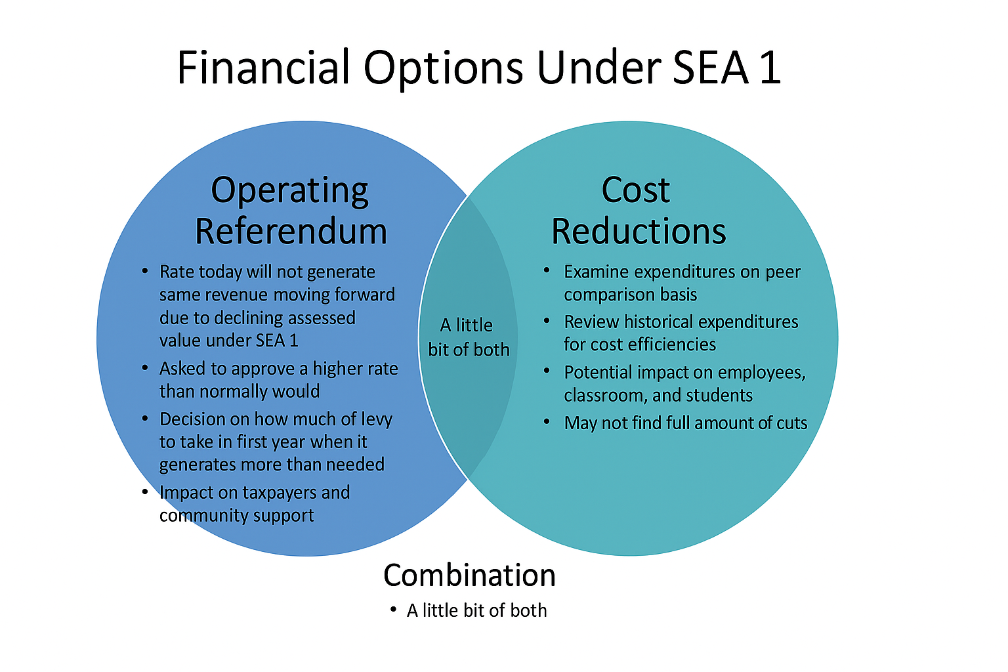

Slide 18
Cash Flows
Baseline with Cuts
Dollars in Thousands | 2024 Actual | 2025 Actual | 2026 Projected | 2027 Projected | 2028 Projected | 2029 Projected | 2030 Projected | 2031 Projected | 2032 Projected | 2033 Projected
Beginning Cash Balance | 4,630.7 | 4,482.4 | 3,202.9 | 1,649.1 | 77.6 | (1,926.2) | (4,090.5) | (6,419.5) | (8,919.9) | (11,587.7)
Receipts
Revenues | 14,874.4 | 16,037.0 | 16,656.7 | 16,815.1 | 16,791.7 | 17,050.6 | 17,315.7 | 17,585.1 | 17,869.6 | 18,161.4
Transfer In | 2,574.3 | 2,798.7 | 1,370.0 | 1,388.0 | 1,407.0 | 1,427.0 | 1,447.0 | 1,467.0 | 1,488.0 | 1,509.0
Total Cash Inflow | 17,448.7 | 18,835.6 | 18,026.7 | 18,203.1 | 18,198.7 | 18,477.6 | 18,762.7 | 19,052.1 | 19,357.6 | 19,670.4
Expenses
Expenditures | (15,471.4) | (17,515.1) | (18,210.5) | (18,386.6) | (18,795.6) | (19,214.9) | (19,644.7) | (20,085.5) | (20,537.5) | (21,001.0)
Transfer Out | (2,125.6) | (2,600.0) | (1,370.0) | (1,388.0) | (1,407.0) | (1,427.0) | (1,447.0) | (1,467.0) | (1,488.0) | (1,509.0)
Total Cash Outflow | (17,597.0) | (20,115.1) | (19,580.5) | (19,774.6) | (20,202.6) | (20,641.9) | (21,091.7) | (21,552.5) | (22,025.5) | (22,510.0)
Surplus (Deficit) | (148.3) | (1,279.5) | (1,553.8) | (1,571.4) | (2,003.9) | (2,164.3) | (2,329.0) | (2,500.4) | (2,667.8) | (2,839.6)
Ending Cash Balance | 4,482.4 | 3,202.9 | 1,649.1 | 77.6 | (1,926.2) | (4,090.5) | (6,419.5) | (8,919.9) | (11,587.7) | (14,427.3)
Ending Cash Balance + Rainy Day | 4,945.6 | 3,574.1 | 2,020.3 | 448.8 | (1,555.0) | (3,719.3) | (6,048.3) | (8,548.7) | (11,216.5) | (14,056.1)
Assumptions
Revenues
Education Fund
1.5% State Tuition increase annually
Operations Fund
Fixed Debt Levy Scenario
Assumes Debt Service Fund is not protected from the new 10%/$300 Homestead Credit starting in 2027 (If protected additional decrease in cash balance of $75K annually)
Expenditures
$400K reduction in non-teacher positions in SY2027
2% Salary & Benefit increases
3-5% Utilities & Other expenditures

Slide 19
Expenditure History (SY)
Education & Operations Fund; Dollars in Thousands
 | 2021 | 2022 | 2023 | 2024 | 2025 |  | 2023 to 2025
 | Actual | Actual | Actual | Actual | Actual |  | $ | %
Expenditures
Salaries | 6,743.1 | 7,338.2 | 8,330.0 | 8,977.2 | 9,706.9 |  | 1,376.9 | 16.5%
Benefits | 2,727.5 | 2,901.0 | 3,211.3 | 3,440.5 | 3,906.6 |  | 695.3 | 21.7%
Purchased Services | 269.2 | 280.7 | 274.6 | 887.4 | 524.6 |  | 250.0 | 91.0%
Supplies & Technology | 206.9 | 235.5 | 182.2 | 243.4 | 510.1 |  | 327.9 | 180.0%
Utilities | 534.4 | 337.6 | 384.8 | 402.0 | 370.5 |  | (14.2) | -3.7%
Insurance | 191.6 | 224.4 | 252.9 | 337.6 | 337.3 |  | 84.4 | 33.4%
Other | 441.9 | 512.9 | 1,261.4 | 1,446.2 | 1,131.5 |  | (129.9) | -10.3%
Total Expenditures | 11,114.5 | 11,830.3 | 13,897.2 | 15,734.3 | 16,487.6 |  | 2,590.4 | 18.6%
Total Revenues | 11,784.4 | 12,485.5 | 14,169.9 | 15,343.1 | 14,961.5 |  | 791.6 | 5.6%

Slide 20
Expenditure History (SY)
Education & Operations Fund; Dollars in Thousands
 | 2021 | 2022 | 2023 | 2024 | 2025 |  | 2023 to 2025
 | Actual | Actual | Actual | Actual | Actual |  | $ | %
Expenditures
General Education | 5,277.9 | 5,672.6 | 6,238.3 | 6,485.9 | 7,605.8 |  | 1,367.5 | 21.9%
Special Education | 844.9 | 1,099.3 | 1,361.2 | 1,734.8 | 1,945.6 |  | 584.4 | 42.9%
Transfer Tuition | 48.2 | 137.8 | 741.4 | 878.8 | 286.8 |  | (454.6) | -61.3%
Educational Support | 1,882.1 | 1,944.7 | 2,290.6 | 2,447.2 | 3,095.0 |  | 804.5 | 35.1%
Capital Projects | 1,990.2 | 1,846.5 | 2,012.5 | 2,892.1 | 2,324.7 |  | 312.2 | 15.5%
Transportation | 364.6 | 450.5 | 541.3 | 598.4 | 528.6 |  | (12.7) | -2.3%
Administrative Support | 706.6 | 679.1 | 711.9 | 697.1 | 701.1 |  | (10.9) | -1.5%
Total Expenditures | 11,114.5 | 11,830.3 | 13,897.2 | 15,734.3 | 16,487.6 |  | 2,590.4 | 18.6%
Total Revenues | 11,784.4 | 12,485.5 | 14,169.9 | 15,343.1 | 14,961.5 |  | 791.6 | 5.6%

Slide 21
Referendum Considerations

Slide 22
Ending Cash Flow Projection
Referendum Considerations
Education, Operations, Operating Referendum, & Rainy Day Funds
Includes $400k in reductions in 2027

Slide 23
Operating Referendum Rate
Referendum Considerations

Slide 24
Referendum Only Impact on Median Taxpayer
Referendum Considerations
2026 Median Homestead GAV: $83,800

Slide 25
Let us know how we can help your district!
POLICY ANALYTICS – SCHOOL SERVICES TEAM
April Fitterling
School Services Project Director
afitterling@policyanalyticsllc.com
574.220.1007
Jason O’Neill
Managing Director
Isaac Ray
Director of Data Systems
Jane Herndon
Project Manager
Matt Parkinson
Project Director
Barry Gardner
Director of School Services
bgardner@policyanalyticsllc.com
317.997.4090
Tracy Boss
Project Coordinator
Addie Hanchett
Senior Fiscal Analyst

